Slide 1

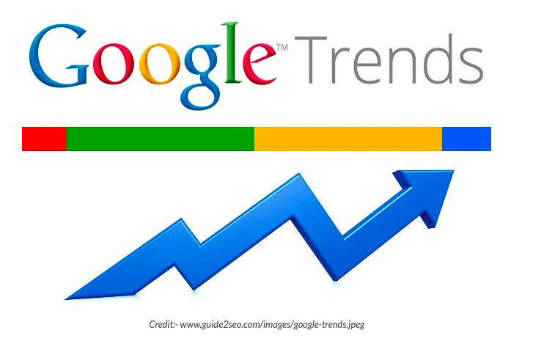
Google Trend Analysis and Incidence of Coronavirus in the United States
Palak Patel, DO; Shakumar Patel, MD; Suhrim Choe, MD; Jagan Mohan Rao Vanjarapu, MD, Premal Patel, MD; Silpa Gudivada, MD; Vinod Nookala, MD; Pramil Cheriyath, MD.
Department of Internal Medicine, Hackensack Meridian Health-Ocean Medical Center, Brick, NJ
Background
Summary
Google trends analyzes the popularity of the most searched questions and queries in google search across various geographical regions and languages.
It allows users to compare the volume of different searches over a period of time.
Google trends is recently being used to predict various things such as election and financial market forecasts.
Also, there is an increase in the use of google trends in the area of various medical topics such as suicide occurrence, parasitic diseases, asthma, and various parasitic infections.
Google trends has also been used to estimate influenza activity in the world.
Recently, the spread of the novel coronavirus has resulted in a global pandemic.
Early detection of the disease activity in a community and prediction of an impending outbreak, followed by a prompt response could reduce overall morbidity and mortality.
Our objective is to look for the correlation between search analysis data in the google trends and incidence of the novel coronavirus in the United states.
This study shows that Google Trends in coronavirus is weakly linked to the incidence of corona virus in the united states.
The trends can give a quantitative data about the public concerns and interests, but may not accurately quantify the opinions or actual events.
Other data sources may be used with google trends to make a good prediction model.
More research in the future should develop new models using search trends in the Chinese language to estimate local disease activity and detect early signs of outbreaks.
Methods
Google trend data using the search term “corona virus” for the past 3 months were collected from the google data base.
Cases of coronary virus in each states were collected from CDC.
Internet search data were downloaded from the website of Google Trends
References:
1. Insights into what the world is searching for -- the new Google Trends, Yossi Matias, Insights Search, The official Google Search blog, September 28, 2012.
2. ""On the Predictability of the U.S. Elections Through Search Volume Activity," at Journalist's Resource.org”
3. Christopher Matthews (April 26, 2013). "Trouble With Your Investment Portfolio? Google It!". TIME Magazine. Retrieved August 9, 2013
4. Christopher Matthews (April 26, 2013). "Trouble With Your Investment Portfolio? Google It!". TIME Magazine. Retrieved August 9, 2013
5. Jeremy Ginsberg; Matthew H. Mohebbi; Rajan S. Patel; Lynnette Brammer; Mark S. Smolinski; Larry Brilliant (2009). "Detecting influenza epidemics using search engine query data". Nature. 457 (7232): 1012–1014.
Results
Pearson's correlation coefficients with 95% confidence intervals (95% CI) were calculated to compare surveillance data and internet search trends.
The correlation between corona virus search in google trends and actual cases of COVID-19 was 0. 2475.

